Slide 1
8TH GRADE JOB SHADOW DAY
April 29, 2021

Slide 2
WHAT IS JOB SHADOW?
The Day of Job Shadow
Will I Get Behind?
An opportunity to observe your dream job with a working professional.
Application of what you learn in school.
Takes place during the school day.
April 29, 2021
Nope!!
No classes are held for 8th graders that day.
Your job shadow assignment counts for all 8 periods.

Slide 3
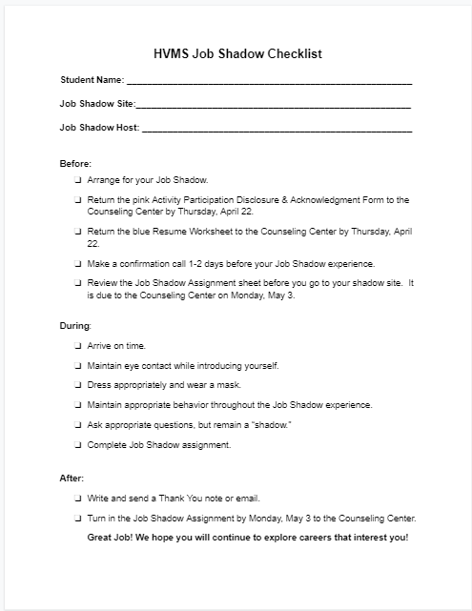
PLANNING FOR JOB SHADOW
Review the packet with your parents!
Don’t know what to do next?
When in doubt, go back to the checklist.
Where? Page 2 of the packet!

Slide 4
STEP 1
Make a list of careers you are interested in.
From the list, choose the best 3 options for your job shadow:
Do I have access to this job?
Do I know someone I could shadow in this career?
How far away is the career?
What are the hours of this job?
With your parents, choose your job shadow occupation.

Slide 5
Step 2
Contact your shadow site and make arrangements.
When? Thursday, April 29, 2021
What happens if I can’t go to my first choice?
Go to your second choice.
Use your parents for guidance.
Move down the list until you find a job shadow site.

Slide 6
Step 2 Continued. . .
How do I make the phone call?
Let’s Practice.
Volunteers?

Slide 7
Step 2 Continued. . .
“Hello, may I please speak with ___________?”
When that person answers:
“Hello, my name is ________________ from Hidden Valley Middle School. I am interested in the _____________ profession and I have the opportunity to shadow a working professional on Thursday, April 29. Are you available to have a job shadow that day?”

Slide 8
Step 2 Continued. . .
If the answer is yes, “Thank you. What time would you like me to meet you?”
If the answer is no, “Not a problem, thank you for your time.”

Slide 9
STEP 3
Fill out the PINK Disclosure Form
Make sure you fill each blank completely!
Parent signature is REQUIRED!
Turn in the pink form to the Counseling Center.
Due: This Thursday, April 22

Slide 10
STEP 4
Complete your BLUE Resume Worksheet.
Turn this in at the Counseling Center.
Due: This Thursday, April 22.

Slide 11
STEP 5
Make a confirmation phone call.
1-2 Days before Job Shadow Day
Make sure to ask:
What time should you arrive?
Where you will meet?
What should you wear?
What should you plan on for lunch?
Look at #5 on page 1 of your packet to practice.
Time to PRACTICE!

Slide 12
Step 6
Review the questions worksheet before you go to your job shadow site.
You may write your answers on the worksheet, you do not need to type it up separately.

Slide 13
STEP 7- Shadow Day Behavior
SHOW UP! If you cannot attend, due to illness, contact your shadow site & the school!
Arrive ON TIME (10 min early is great!)
Dress Appropriately
It’s better to overdress than underdress
Get your clothes ready the night before.
Be on your BEST behavior. You are representing not only yourself, but the school. Please remain a SHADOW.
Complete the Job Shadow Assignment.

Slide 14
Step 8- Follow Up
Write and send a Thank You card or email.
Turn in your Job Shadow assignment to the Counseling Center.
Due: Monday, May 3rd.

Slide 15
LET’S PRACTICE!!

Slide 16
THE GREETING
DIRECT EYE CONTACT
FIRM HANDSHAKE
HELLO MY NAME IS_____________
HOW ARE YOU TODAY?
VS

Slide 17
DRESS
Business Casual
Dress Pants or Skirt (to the knee)
Blouse / Shirt with Collar
Nice Shoes

Slide 18
Appropriate?

Slide 19
Make the BEST out of Job Shadow
This is YOUR time to find a career you are interested in, so find something that is interesting to you.
Take a picture so we can document the cool things you are doing!
Email it to your counselor…and get a treat!
When you turn in your Job Shadow Assignment on May 3, you will be entered into a drawing for some cool prizes!

